Slide 1
CEO remuneration study 2018
Executive remuneration research centre

Slide 2
1
sample

Slide 3
countries
Country | Stock market index | # | # matched sample (14-17)
Belgium | Bel20, Bel Mid, Bel Small | 76 | 35
Netherlands | AEX, AMX, AScX | 70 | 31
Germany | DAX, MDAX, SDAX | 103 | 45
France | CAC40, CAC Next 20, CAC Mid, CAC Small | 222 | 103
UK | FTSE 100, FTSE 350 | 288 | 39
Sweden | OMXS 60 | 58 | 0
Switzerland | SMI Expanded | 45 | 0
Companies with market cap < 100mn are excluded, except for B and NL

Slide 4
2
CEO remuneration levels

Slide 5
Median Total Ceo REMUNERATION PER STOCK MARKET INDEX - large cap
 | Total remuneration
 | 2016 | 2017
Bel 20 (B) | 2.080.000 | 1.975.000
AEX (NL) | 2.940.000 | 3.590.000
DAX (D) | 5.555.000 | 6.205.000
CAC 40 (F) | 4.615.000 | 4.440.000
CAC Next 20 (F) | 2.465.000 | 3.080.000
FTSE 100 (UK) | 4.300.000 | 3.830.000
OMXS60 (S) | 1.510.000 | 1.740.000
SMI Expanded (CH) | n.a. | 3.245.000

Slide 6
Median CEO total remuneration Focus on aex – evolution 2016-2017

Slide 7
Median Total Ceo REMUNERATION PER STOCK MARKET INDEX - Mid cap
 | Total remuneration
 | 2016 | 2017
Bel Mid (B) | 690.000 | 865.000
AMX (NL) | 1.080.000 | 1.180.000
MDAX (D) | 2.765.000 | 2.710.000
CAC Mid (F) | 2.065.000 | 2.040.000
FTSE 250 (UK) | 2.060.000 | 2.090.000

Slide 8
Median Total Ceo REMUNERATION PER STOCK MARKET INDEX - small cap
 | Total remuneration
 | 2016 | 2017
Bel Small (B) | 560.000 | 525.000
AScX (NL) | 785.000 | 775.000
SDAX (D) | 1.435.000 | 1.265.000
CAC Small (F) | 400000 | 460.000

Slide 9
CEO total remuneration 2017 Quartiles
 | P25 | P50 | P75
AEX | 2.270.000 | 3.590.000 | 4.820.000
AMX | 880.000 | 1.180.000 | 1.595.000
AScX | 660.000 | 775.000 | 955.000

Slide 10
Median Ceo REMUNERATION PER STOCK MARKET INDEX - large cap
 | Fixed |  | STI |  | LTI
 | 2016 | 2017 | 2016 | 2017 | 2016 | 2017
Bel 20 (B) | 705.000 | 650.000 | 560.000 | 540.000 | 1.155.000 | 705.000
AEX (NL) | 990.000 | 1.035.000 | 780.000 | 1.070.000 | 1.260.000 | 1.820.000
DAX (D) | 1.425.000 | 1.380.000 | 2.060.000 | 1.750.000 | 1.535.000 | 3.710.000
CAC 40 (F) | 1.100.000 | 1.100.000 | 1.325.000 | 1.480.000 | 2.190.000 | 1.805.000
CAC Next 20 (F) | 800.000 | 750.000 | 860.000 | 1.015.000 | 1.380.000 | 1.925.000
FTSE 100 (UK) | 1.045.000 | 1.025.000 | 1.150.000 | 1.245.000 | 2.210.000 | 2.135.000
OMXS60 (S) | 1.005.000 | 990.000 | 570.000 | 555.000 | 470.000 | 870.000
SMI Expanded (CH) | n.a. | 940.000 | n.a. | 1.215.000 | n.a. | 1.300.000

Slide 11
Median Ceo REMUNERATION PER STOCK MARKET INDEX - Mid cap
 | Fixed |  | STI |  | LTI
 | 2016 | 2017 | 2016 | 2017 | 2016 | 2017
Bel Mid (B) | 480.000 | 450.000 | 230.000 | 195.000 | 170.000 | 150.000
AMX (NL) | 600.000 | 565.000 | 260.000 | 315.000 | 355.000 | 380.000
MDAX (D) | 830.000 | 925.000 | 775.000 | 830.000 | 940.000 | 1.375.000
CAC Mid (F) | 700.000 | 700.000 | 665.000 | 680.000 | 860.000 | 665.000
FTSE 250 (UK) | 665.000 | 650.000 | 525.000 | 620.000 | 905.000 | 965.000

Slide 12
Median Ceo REMUNERATION PER STOCK MARKET INDEX - small cap
 | Fixed |  | STI |  | LTI
 | 2016 | 2017 | 2016 | 2017 | 2016 | 2017
Bel Small (B) | 370.000 | 425.000 | 125.000 | 90.000 | 70.000 | 95.000
AScX (NL) | 455.000 | 460.000 | 170.000 | 160.000 | 225.000 | 205.000
SDAX (D) | 590.000 | 610.000 | 385.000 | 450.000 | 550.000 | 455.000
CAC Small (F) | 250.000 | 310.000 | 130.000 | 155.000 | 370.000 | 175.000

Slide 13
3
CEO remuneration structure

Slide 14
CEO Target bonus percentages – large cap
 | % disclosing target bonus | Target bonus %
Bel 20 (B) | 40% | 65%
AEX (NL) | 76% | 100%
DAX (D) | 87% | 100%
CAC 40 (F) | 63% | 100%
CAC Next 20 (F) | 55% | 100%
FTSE 100 (UK) | 40% | 100%
OMXS60 (S) | 10% | 113%
SMI Expanded (CH) | 62% | 100%
Light grey shading = not enough observations

Slide 15
CEO Target bonus percentages – Mid cap
 | % disclosing target bonus | Target bonus %
Bel Mid (B) | 12% | 76%
AMX (NL) | 63% | 67%
MDAX (D) | 52% | 90%
CAC Mid (F) | 44% | 100%
FTSE 250 (UK) | 33% | 75%
Light grey shading = not enough observations

Slide 16
CEO Target bonus percentages – small cap
 | % disclosing target bonus | Target bonus %
Bel Small (B) | 14% | 75%
AScX (NL) | 36% | 50%
SDAX (D) | 26% | 71%
CAC Small (F) | 7% | 77%
Light grey shading = not enough observations

Slide 17
4
What drives CEO remuneration?

Slide 18
What drives CEO total remuneration level?
Factor | Significant relationship with total remuneration? | Coefficient
Market cap | X | 0,663
Sector | X | Less in real estate
Country | X | Cf. infra
Profitability (ROA) | X | -0,058
CEO age
CEO tenure
Insider CEO
Foreign CEO | X | 0,070
Ownership dispersion | X | 0,160

Slide 19
What drives ceo total remuneration level? Country effects
 | A view from The Netherlands
Belgium
Netherlands
Germany | 42% (12%)
France
UK | 37% (13%)
Sweden
Switzerland
CEOs of firms listed in Germany earn 42% more than CEOs of firms listed in the Netherlands
CEOs of firms listed in the UK earn 37% more than CEOs of firms listed in the Netherlands

Slide 20
The impact of firm size over the years

Slide 21
What drives bonus pay-out relative to target?
Factor | Related? | Coefficient
Market cap | X | 0,317
Sector | X
Country | X
Profitability (ROA)
CEO age
CEO tenure
Insider CEO | X | Outsider>Insider (-0,133)
Foreign CEO
Total shareholder return | X | 0,241
Ownership dispersion | X | 0,168
CEO is Executive Director
Notes:
Here, we try to find out which factors play a role to explain the extent to which firms have a higher bonus payout than the target level.
Sector:
industrials > consumer discretionary
communication services > consumer discretionary
communication services > real estate
financials > consumer discretionary
Country:
Sweden and Switzerland < Belgium
Sweden and Switzerland < The Netherlands

Slide 22
Occurrence of Share-based remuneration IN THE NETHERLANDS
Notes:
Shares (TB & PB), Stock options (TB & PB), NC

Slide 23
What drives the occurrence of share-based remuneration?
Factor | Significant relationship with share-based remuneration? | Coefficient
Market cap | X | 0,257
Sector
Country | X
Profitability (ROA)
CEO age
CEO tenure
Insider CEO
Foreign CEO
Total shareholder return
Ownership dispersion | X | 0,174
CEO is Executive Director
Notes:
Country: lower occurrence of share-based remuneration in Germany.

Slide 24
5
Key performance indicators

Slide 25
Key performance indicators used in incentive plans

Slide 26
Key performance indicators used in incentive plans
Weight of financial KPIs | STI | LTI
P25 | 60% | 100%
P50 | 75% | 100%
P75 | 90% | 100%

Slide 27
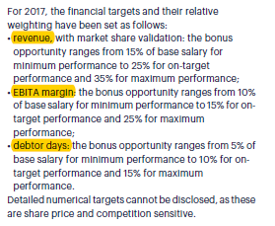
Kpis underlying short-term incentives

Slide 28
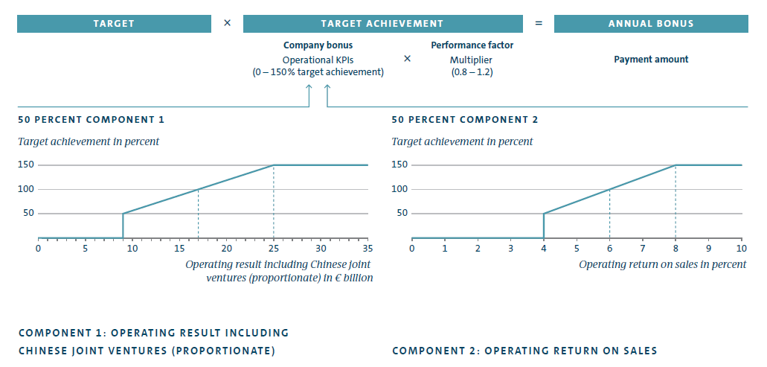
KPIs underlying Short-term incentives

Slide 29
Kpis underlying long-term incentives

Slide 30
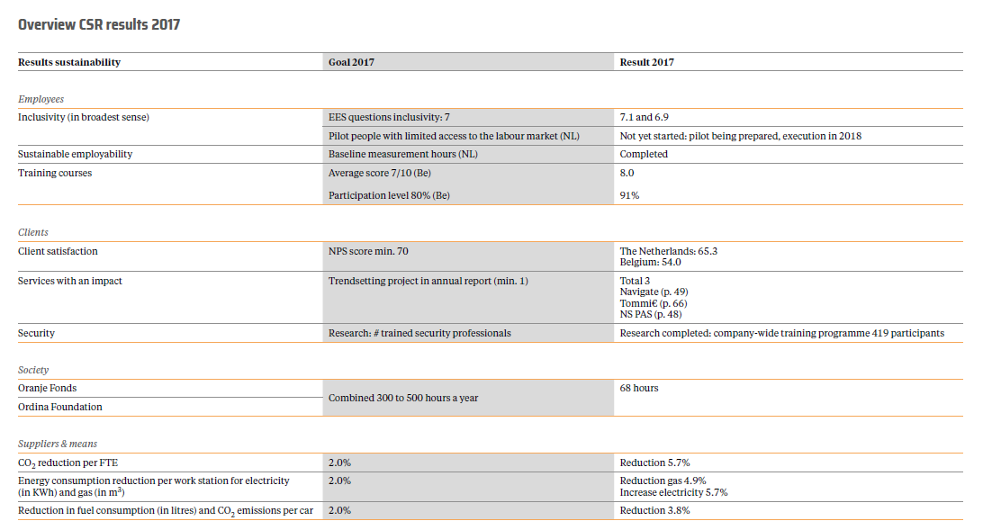

Slide 31
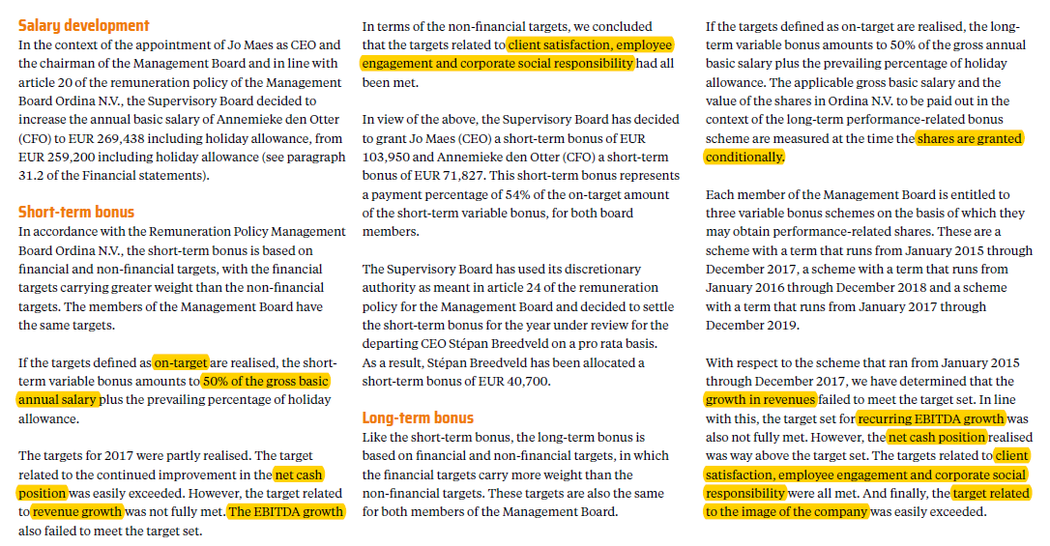

Slide 32
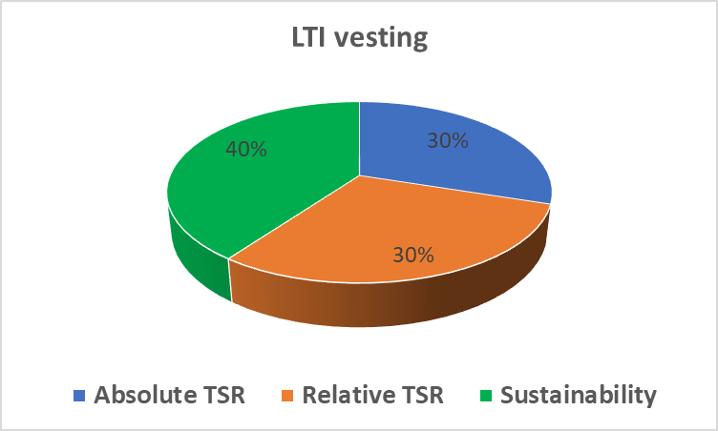
Energy/CO2 reduction (10%%)
Waste & recycling (10%)
Employee satisfaction (10%)
Management development/succession (10%)

Slide 33
6
Putting the lens on long-term incentives

Slide 34
Typology of long-term incentives per country
 | Stock options |  | Performance shares |  | Phantom stock |  | Cash |  | Restricted stock
 | 2016 | 2017 | 2016 | 2017 | 2016 | 2017 | 2016 | 2017 | 2016 | 2017
Belgium | 36% | 37% | 7% | 13% | 4% | 3% | 4% | 8% | 4% | 5%
Netherlands | 19% | 7% | 49% | 41% | 1% | 0% | 3% | 4% | 1% | 4%
Germany | 6% | 2% | 14% | 12% | 32% | 16% | 42% | 52% | 1% | 1%
France | 10% | 9% | 37% | 38% | 3% | 2% | 3% | 4% | 1% | 3%
UK | 7% | 6% | 45% | 79% | 1% | 0% | 0% | 1% | 1% | 5%
Sweden | 8% | 0% | 36% | 60% | 3% | 0% | 14% | 3% | 0% | 5%
Switzerland | n.a. | 13% | n.a. | 65% | n.a. | 0% | n.a. | 0% | n.a. | 9%

Slide 35
LTI – vesting period

Slide 36
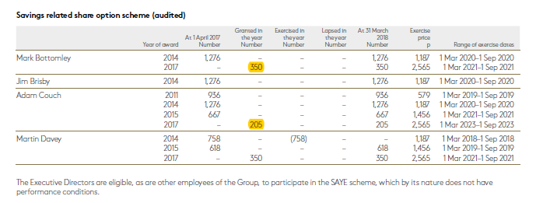
LTI - Vesting period
6 year vesting

Slide 37
Lti - Vesting period
Instalment vest over 9 years

Slide 38
LTI – holding period
2 years

Slide 39
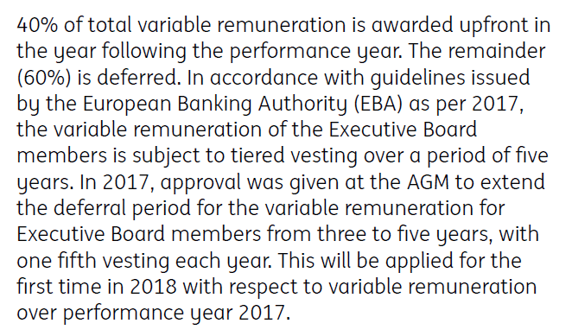
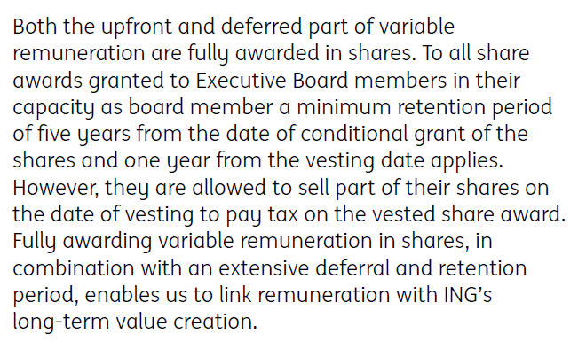
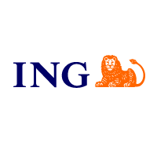
Lti - Holding period

Slide 40
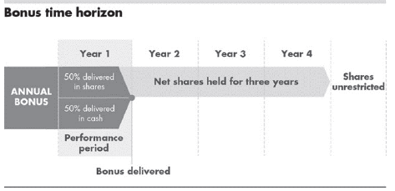
Lti - Holding period

Slide 41
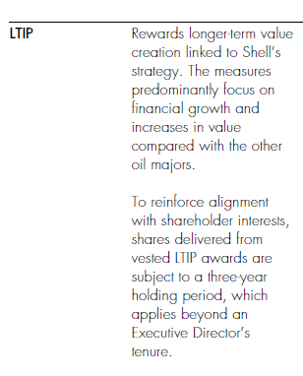
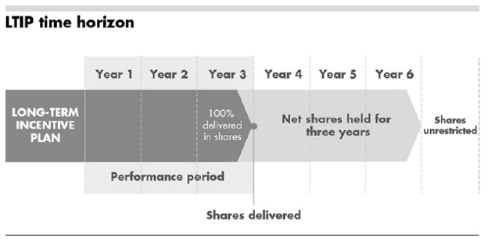
Lti - Holding period

Slide 42
Lti - Holding period

Slide 43
Shareholding requirement
200% base pay
Notes:
200% base pay is the most frequent. Goes to 400 times base pay.

Slide 44
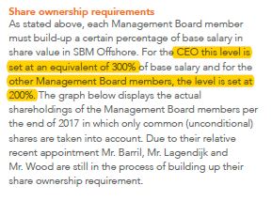
Shareholding requirement

Slide 45
Ceo REMUNERATION FROM A LONG-term shareholder value perspective
Our criteria:
Granting share-based remuneration
Longest vesting/holding period more than 3 years
Country | % of firms | N
Belgium | 12% | 9/76
The Netherlands | 26% | 18/70
France | 18% | 39/221
Sweden | 3% | 1/40
UK | 42% | 122/288
Germany | 9% | 9/97
Switzerland | 20% | 9/46
207/838

Slide 46
What drives long term shareholder value perspective in rewards?
Factor | Related? | Coefficient
Market cap | X | 0,270
Sector
Country | X
Profitability (ROA)
CEO change
CEO age
CEO tenure
Insider CEO
Foreign CEO
Total shareholder return
Ownership dispersion | X | 0,115
CEO is Executive Director

Slide 47
What drives sustainability KPIS in sti?
Our criteria:
Safety, environment, CSR, employee- or customer-related KPIS
Country | % of firms | N
Belgium | 32% | 18/57
The Netherlands | 41% | 24/58
France | 40% | 64/162
Sweden | 13% | 2/16
UK | 61% | 170/279
Germany | 12% | 10/83
Switzerland | 26% | 11/43
139/698

Slide 48
What drives sustainability KPIS in sti?
Factor | Related? | Coefficient
Market cap | X | 0,237
Sector | X
Country | X
Profitability (ROA) | X | -0,094
CEO change
CEO age
CEO tenure
Insider CEO
Foreign CEO
Total shareholder return
Ownership dispersion
CEO is Executive Director

Slide 50
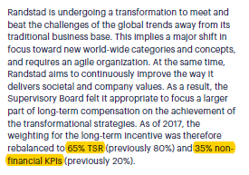
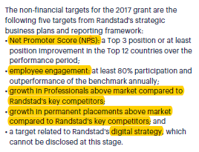

Slide 51
7
Learnings on Ownership dispersion

Slide 52
Link with ownership dispersion
Factor | Related? | Coefficient & comment
Total remuneration | X | More dispersed, higher total remuneration
Target bonus %
Target bonus pay-out | X | More dispersed, higher target bonus pay-out
Share based remuneration | X | More dispersed, higher occurrence of share-based remuneration
Non financial KPI’s
Pension contribution
Voting dissent | X | More dispersed ->more dissent
Long term shareholder value perspective | X | Companies with dispersed ownership make more use of LTI with long term perspective
Non-financial KPIs in STI | X | Companies with dispersed ownership use less non-financial KPIs

Slide 53
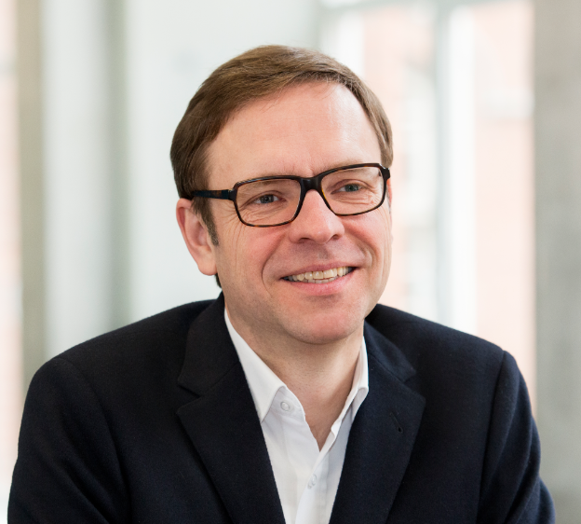
HAPPY
TO CONNECT
xavier.baeten@vlerick.com
www.linkedin.com/in/xavier-baeten

